Slide 1
CUDA Advanced Libraries
cuFFT Syntax

Slide 2
Sample cuFFT Code
#define NX 64 #define NY 64 #define NZ 128 cufftHandle plan; cufftComplex *data1, *data2;
cudaMalloc((void**)&data1, sizeof(cufftComplex)*NX*NY*NZ); cudaMalloc((void**)&data2, sizeof(cufftComplex)*NX*NY*NZ);
cufftPlan3d(&plan, NX, NY, NZ, CUFFT_C2C); // Create a 3D FFT plan cufftExecC2C(plan, data1, data1, CUFFT_FORWARD); cufftExecC2C(plan, data2, data2, CUFFT_FORWARD);
cufftDestroy(plan); cudaFree(data1); cudaFree(data2);

Slide 3
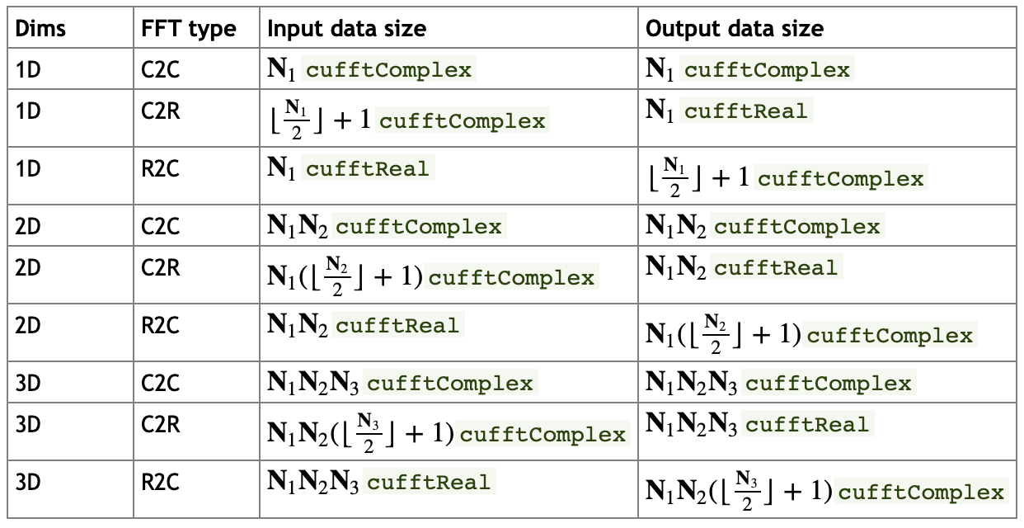
cuFFT Input/Output Sizes
[1]

Slide 4
cuFFT Multi-Dimensional Transforms
Multiple dimensional transforms (1-3d) are possible
The total size of input/output data follows previous table (1d) but is the product of the data sizes in each dimension, so much smaller for each dimension
You can input/output from/to subsets of large data
This can come in handy to solve larger problems

Slide 5
Multiple GPU Support
cufftXtSetGPUs – pass GPU ids to plan to process across GPUs
cufftMakePlan – Actually create the 1 – Many dimensional plan like before
All other functions follow the pattern:
cufftXtFUNCTION_NAME
e.g. cufftXtMalloc
Like before cufftDestroy - destroy the plan and free any resources
[1]

Slide 6
References
[1] 2021. NVIDIA. CUDA Developer Toolkit Documentation. Found at https://docs.nvidia.com/cuda/cufft/index.html.

